Slide 1

CYBERX CHATBOT PRESENTATION PART 1 AND 2
BY MUHLURI AVRIL NKUNA

Slide 2
Introduction to CyberX Chatbot
CyberX is an interactive, console-based chatbot developed in C# with the purpose of educating users about essential cybersecurity principles in a conversational and engaging manner. Designed with both beginners and everyday internet users in mind, CyberX offers a personalized experience that blends educational content with an approachable, user-friendly interface.
Upon launch, CyberX welcomes users with a custom ASCII logo and optional voice greeting, simulating a polished and professional virtual assistant. The chatbot employs real-time typing effects to enhance immersion and realism, making users feel as if they are chatting with a real cybersecurity coach.
CyberX focuses on six key areas of digital safety:
🔐 Password Safety – Best practices for creating and maintaining secure passwords.
🐟 Phishing Awareness – Recognizing and avoiding malicious emails and scams.
🌐 Safe Browsing Habits – Tips for navigating the internet securely.
📱 Social Media Security – How to protect your identity and privacy on platforms.
📶 Public Wi-Fi Risks – Understanding threats in unsecured networks.
🎭 Identifying Online Scams – Spotting and avoiding deceptive tactics.
By using color-coded text, simulated typing, and optional audio enhancements, CyberX goes beyond static content to deliver a dynamic learning experience. The structure is modular, allowing future integration with AI APIs, GUI frameworks (e.g., WinForms, WPF), or web interfaces.

Slide 3
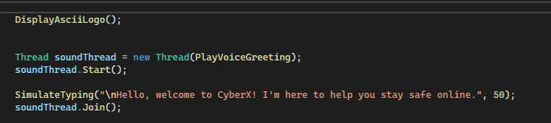
About CyberX
CyberX is an interactive console-based chatbot designed to educate users about cybersecurity in a friendly and engaging way. It opens with a stylized logo and audio greeting, followed by a menu-driven conversation where users can explore various cyber safety topics. The chatbot simulates typing and uses colored text to improve interaction and learning experience.

Slide 4
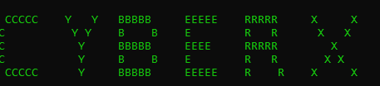
ASCII Branding CyberX ASCII Logo
To create a strong visual identity, the program features a branded ASCII logo displayed in green. This is the first element users see and helps build a recognizable and consistent interface.

Slide 5
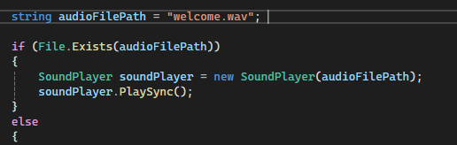
Voice Greeting Integration
Voice Interaction – Welcome Sound
To enhance accessibility and interactivity, the chatbot plays a voice greeting from a .wav file when the application starts. This makes the user feel welcomed and improves the overall experience.

Slide 6
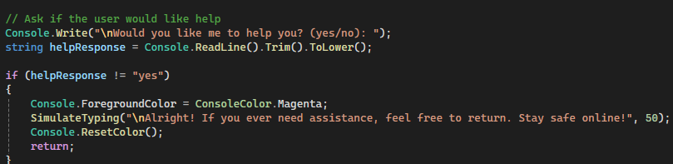
Personalized Chat Flow Engaging the User
CyberX uses a simple question to check if the user wants assistance. If the answer is yes, it requests their name to personalize the responses, making the interaction feel human and relatable.

Slide 7
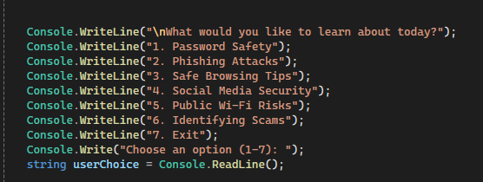
Main Menu Navigation Cyber Topics Menu
The main chatbot loop presents a clear menu of six key cybersecurity topics. Users can explore each section at their own pace, and the chatbot guides them with clear instructions and tips.

Slide 8
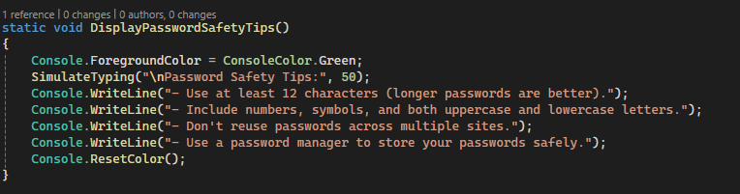
Educational Tips – Example Password Safety Guidance
Each menu option reveals a set of easy-to-understand, practical safety tips. For example, under "Password Safety", users learn about length, complexity, and the value of using password managers.

Slide 9

Voice + Typing Effect Typing Simulation
To simulate a human conversation, the chatbot displays text character-by-character with a typing delay. This keeps the user focused and creates a calm reading pace.
foreach (char c in message)
{
Console.Write(c);
Thread.Sleep(delay);
}

Slide 10
Color Coding for Readability Color Integration
Console colors are used to highlight different types of messages:
Green for topic headings
Magenta for farewells
Red for errors or invalid inputs

Slide 11
Exiting the Chat User-Friendly Exit
When users choose to exit, CyberX closes the chat with a personalized thank-you message. This polite and respectful ending reinforces the importance of cybersecurity.

Slide 12
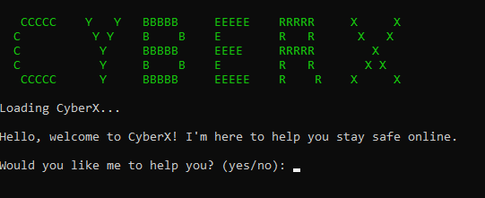
Conclusion
CyberX is more than a chatbot , it's an interactive learning assistant. By combining text, color, typing simulation, and voice interaction, the program delivers a friendly and effective experience that raises awareness about staying safe online. Future improvements could include GUI implementation and real-time chat features.

Slide 13
PART 2

Slide 14
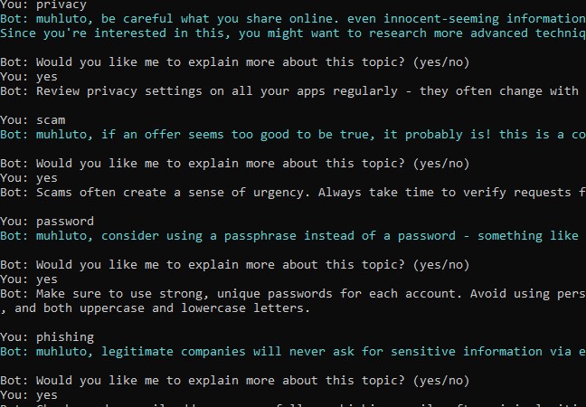
1. Keyword Recognition
Chatbot recognises cybersecurity-related keywords like 'password', 'scam', and 'privacy'.
Provides tips and guidance for each keyword.
Enhances user learning through relevant responses.

Slide 15
2. Randomised Responses
Randomly selects one of several responses for topics like 'phishing'.
Uses arrays or lists to store responses.
Improves conversation variety and engagement.

Slide 16

4. Memory and Recall
Remembers user details like name and interests.
Personalises cybersecurity advice.
Uses a dictionary to store and recall user data.

Slide 17
3. Conversation Flow
Maintains topic continuity during follow-up questions.
Handles deeper or clarifying questions without restarting.
Supports natural, fluid conversation

Slide 18
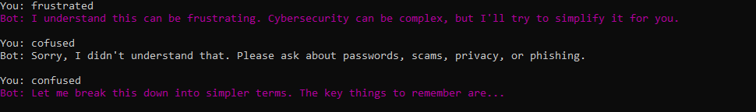
. Sentiment Detection
Detects user emotions (worried, frustrated, curious).
Adjusts tone of response to be supportive.
Creates empathetic interaction for user comfort

